Slide 1
Electric Vehicles, Prices and Electric Range
Leo, Naomi, Hamidreza, Khaled

Slide 2
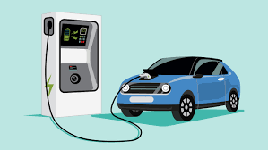
Introduction & Background
Electric Vehicles are gaining popularity due to their benefits
  Reduction of carbon emissions
  Cost savings
  Innovation to technology
Started to become popular around 2010
Awareness for carbon reduction
MSRP
  Manufacturer Suggested Retail Price
PHEV:
  Plug-in Hybrid electric vehicles (Hybrid)
BEV:
  Battery Electric Vehicle (Full electric)
Electric Range
  Distance (in miles) before vehicles turns off

Slide 3
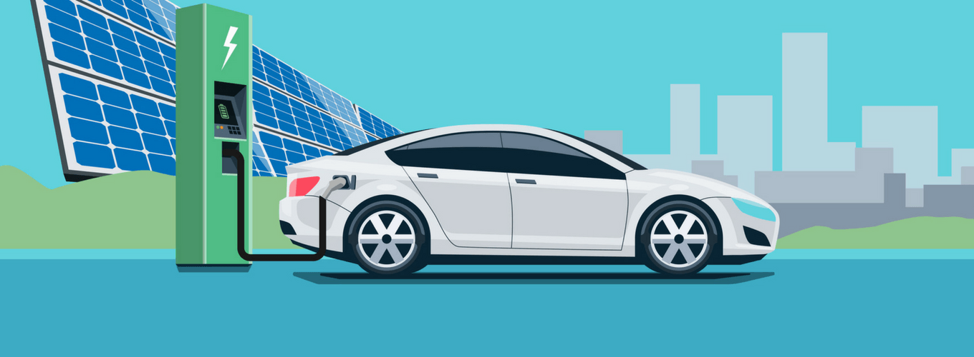
Question of interest?
What is the relationship between MSRP, and Electric Range per Full Electric Vehicles and Hybrid Vehicles?
  Brand
  Full vs Hybrid

Slide 4
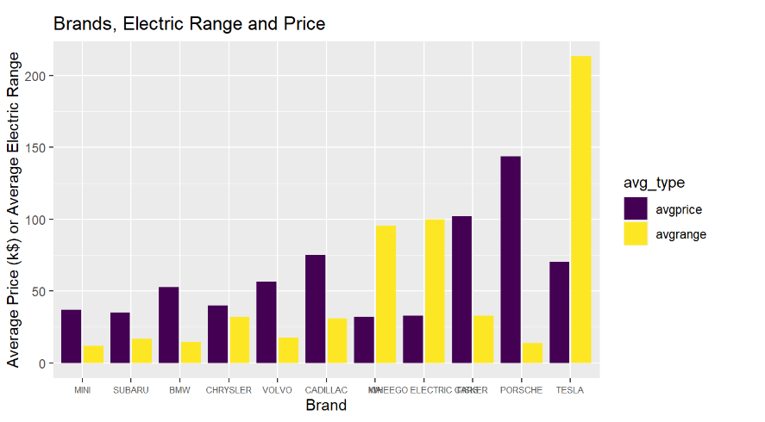
Analysis
This graph compares MSRP and Electric Range for each company.
Looking at this graph
  Relationship varies between brands
  Tesla is the best brand in terms of these constrictions
  Porsche is the worst brand in terms of these constrictions

Slide 5
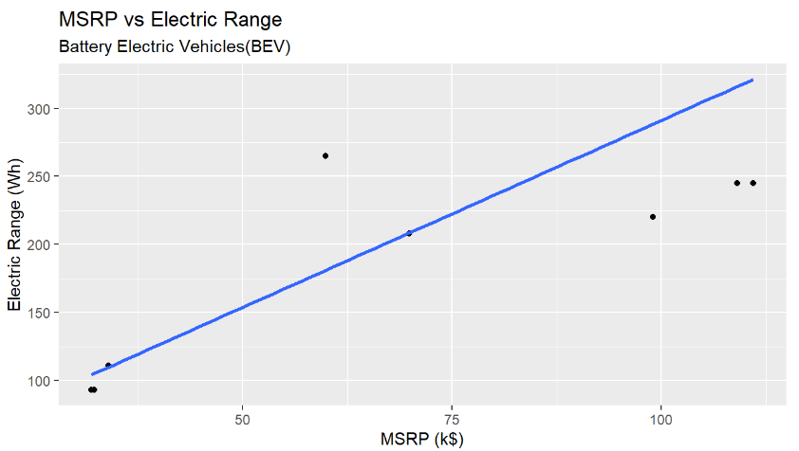
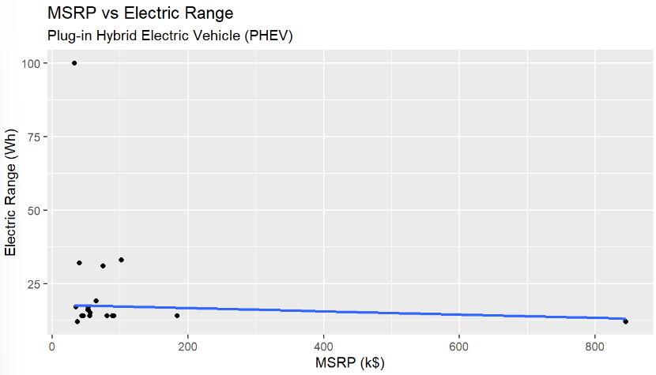
Analysis
These graphs represent MSRP between Hybrid vehicles and fully electric vehicles.
Looking at these graphs:
  MSRP and Electric range have a linear relationship
  Positive correlation in Fully electric vehicles indicates that higher-priced vehicles generally have better battery endurance.
  Negative correlation in Hybrid electric vehicles indicates that some higher-priced vehicles may not necessarily offer better battery endurance.

Slide 6
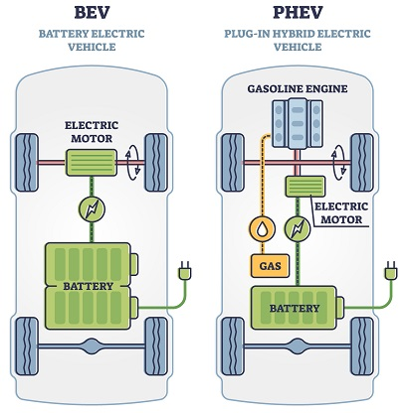
Conclusion
The data shows that Teslas have the highest average range while Porsches are the most expensive.
Luxury brands like Porsche may not necessarily provide the best value for money in terms of battery endurance and long-term cost savings.
Tesla's end up being the best choice for consumers, with a lower MSRP and the highest average electric range.
Full electric vehicles seem to follow the pattern that as the price increases, the range does as well.
Having more space for the battery allows for the use of more advanced and efficient technology which provides better battery endurance and extended driving ranges when compared to PHEVs.

